Slide 1
College admission Agent
IBM AICTE PROJECT
Presented By: Ansh Kataria
Student name : Ansh Kataria
College Name & Department : Management Education and Research Institute & BCA

Slide 2
OUTLINE
Problem Statement
Technology used
Wow factor
End users
Result
Conclusion
Git-hub Link
Future scope
IBM Certifications

Slide 3
Problem Statement
Prospective students face delays and confusion during college admissions due to scattered information, unclear eligibility criteria, and lack of real-time support.
Proposed Solution: An AI-powered College Admission Agent using Retrieval-Augmented Generation (RAG) that provides instant, accurate responses to student queries by retrieving information from official documents. It simplifies course selection, application guidance, and fee-related inquiries using IBM Watsonx and Granite models.

Slide 4
Technology used
IBM cloud lite services
Natural Language Processing (NLP)
Retrieval Augmented Generation (RAG)
IBM Mistral-large model

Slide 5
IBM cloud services used
IBM Cloud Watsonx AI Studio
IBM Cloud Watsonx AI runtime
IBM Cloud Agent Lab
IBM Mistral-large model

Slide 6
Wow factors
Instant Answers, Real-Time Help: Students get immediate, accurate responses to questions about admissions, eligibility, fees, and deadlines—no more waiting or digging through websites.
Natural Conversation Flow: The agent understands how students talk. Just ask a question like you're chatting with a friend, and it responds smartly using IBM Mistral-Large.
Powered by Trusted Data: All information comes directly from official documents and policies, ensuring every answer is reliable and up-to-date.
24/7 Accessibility: No need to wait for office hours. The agent is always available, making the admission process easier anytime, anywhere.
Built for the Future: With IBM Watsonx and RAG architecture, the solution is scalable, secure, and ready to adapt to new courses, rules, or user needs.

Slide 7
End users
Prospective Students
Parents & Guardians
College Website Visitors
Admission Counsellors/Helpdesk Staff

Slide 8
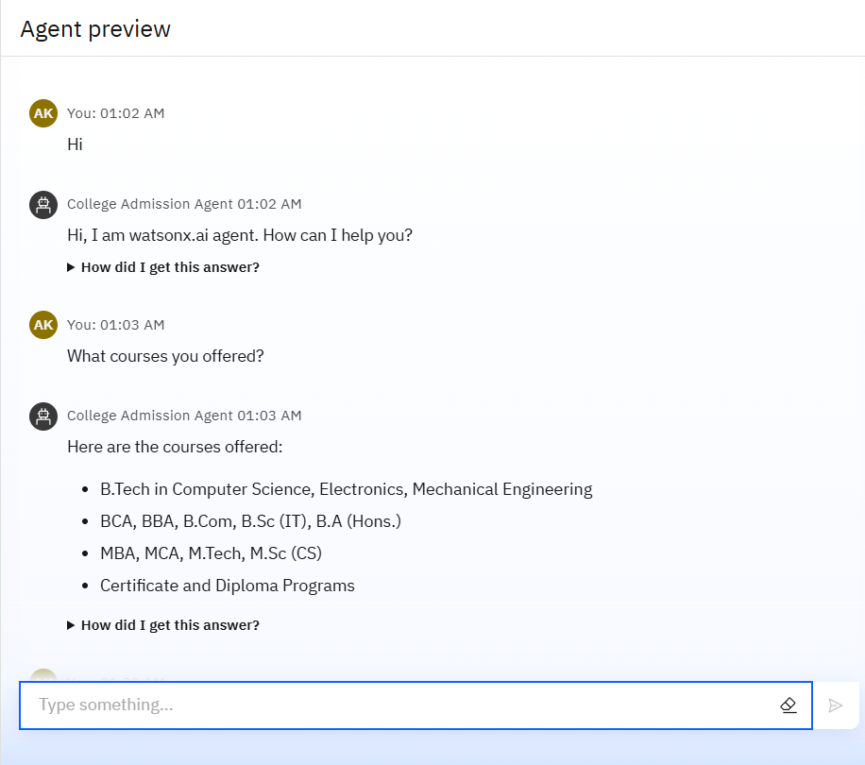
Results

Slide 9
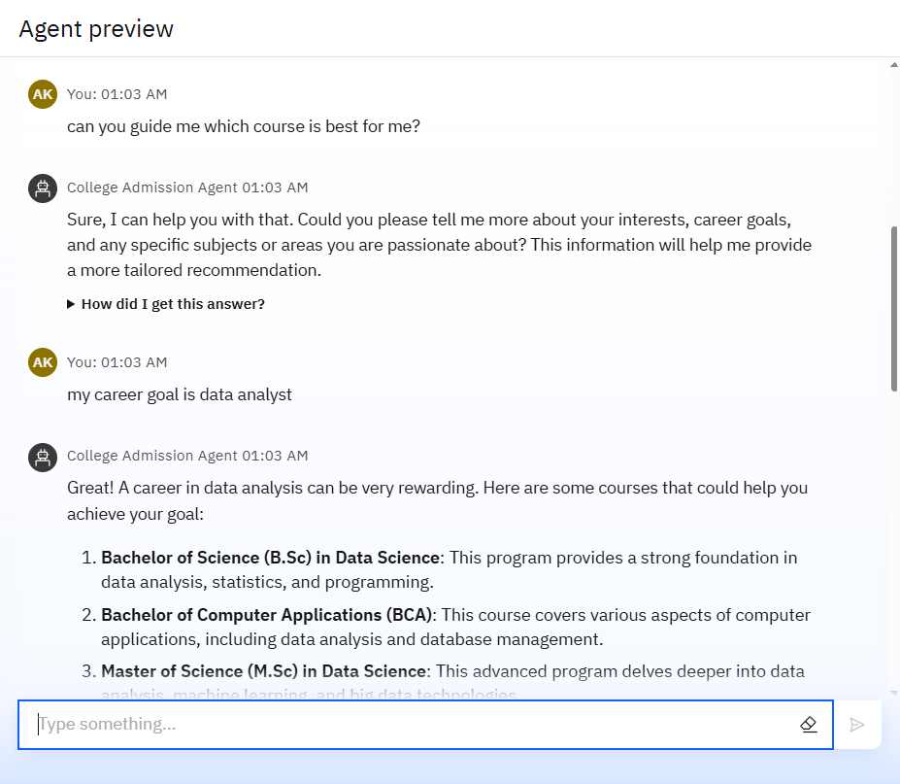
Results

Slide 10
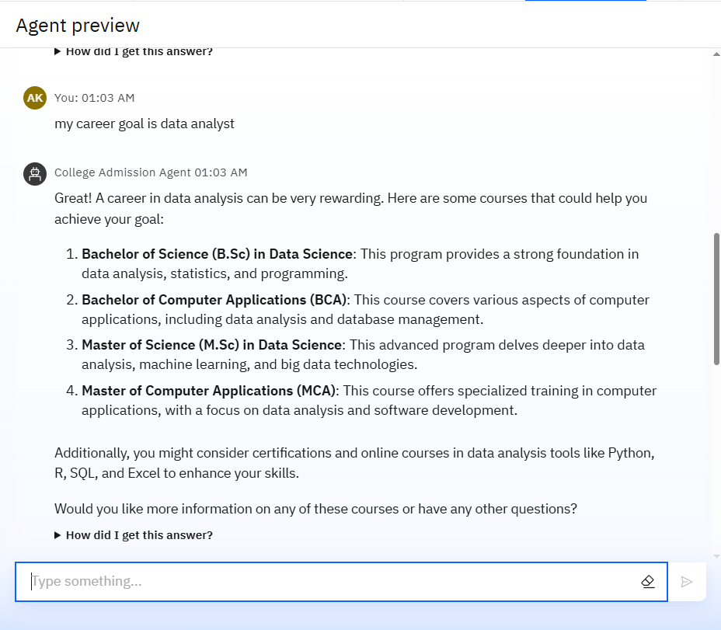
Results

Slide 11
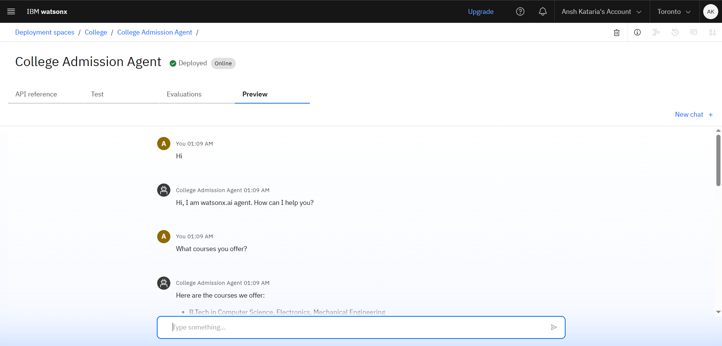
Results
Deployed AI Agent

Slide 12
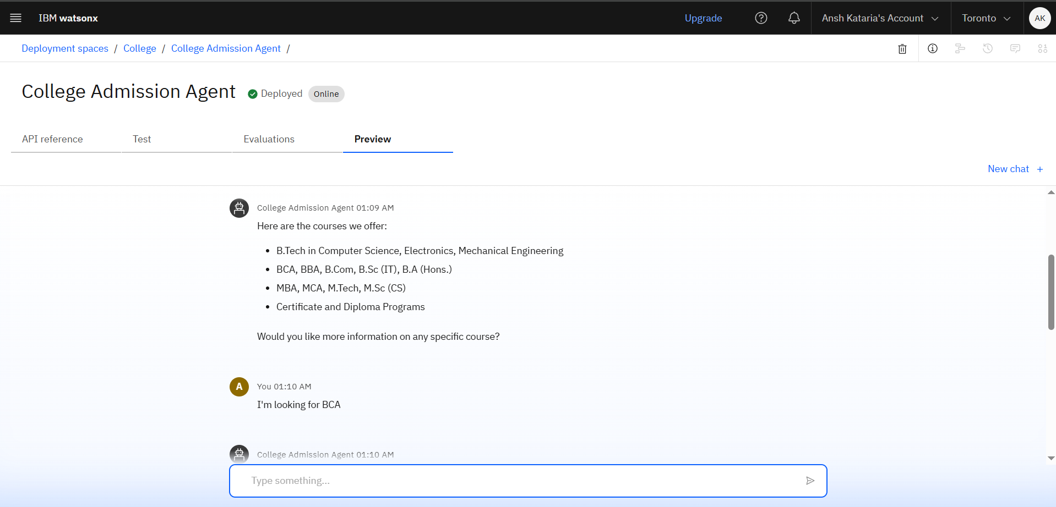
Results
Deployed AI Agent

Slide 13
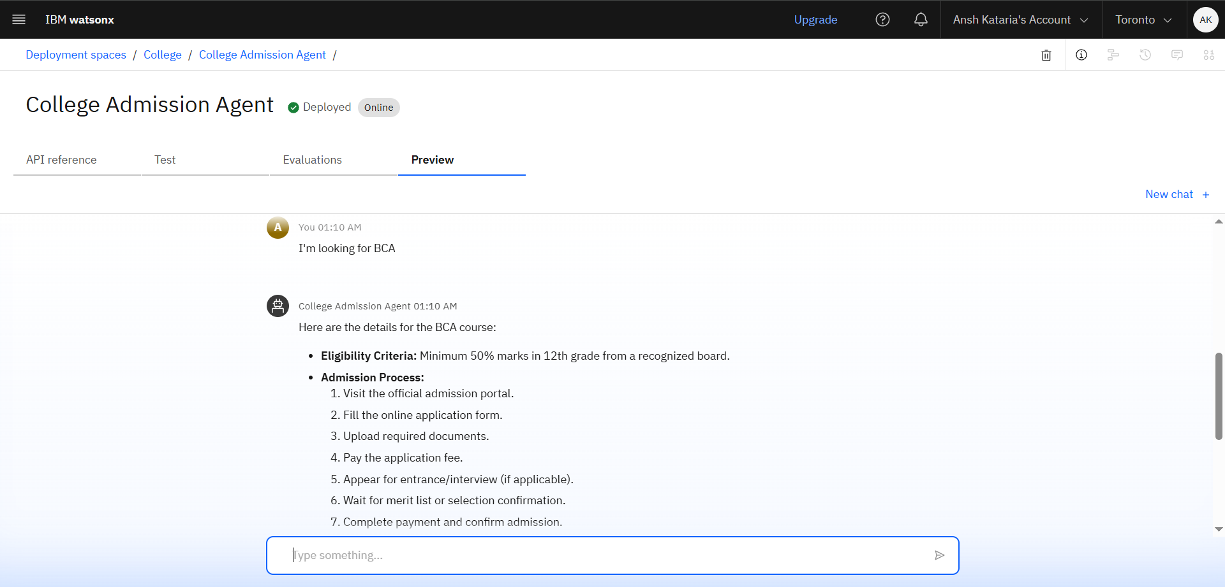
Results
Deployed AI Agent

Slide 14
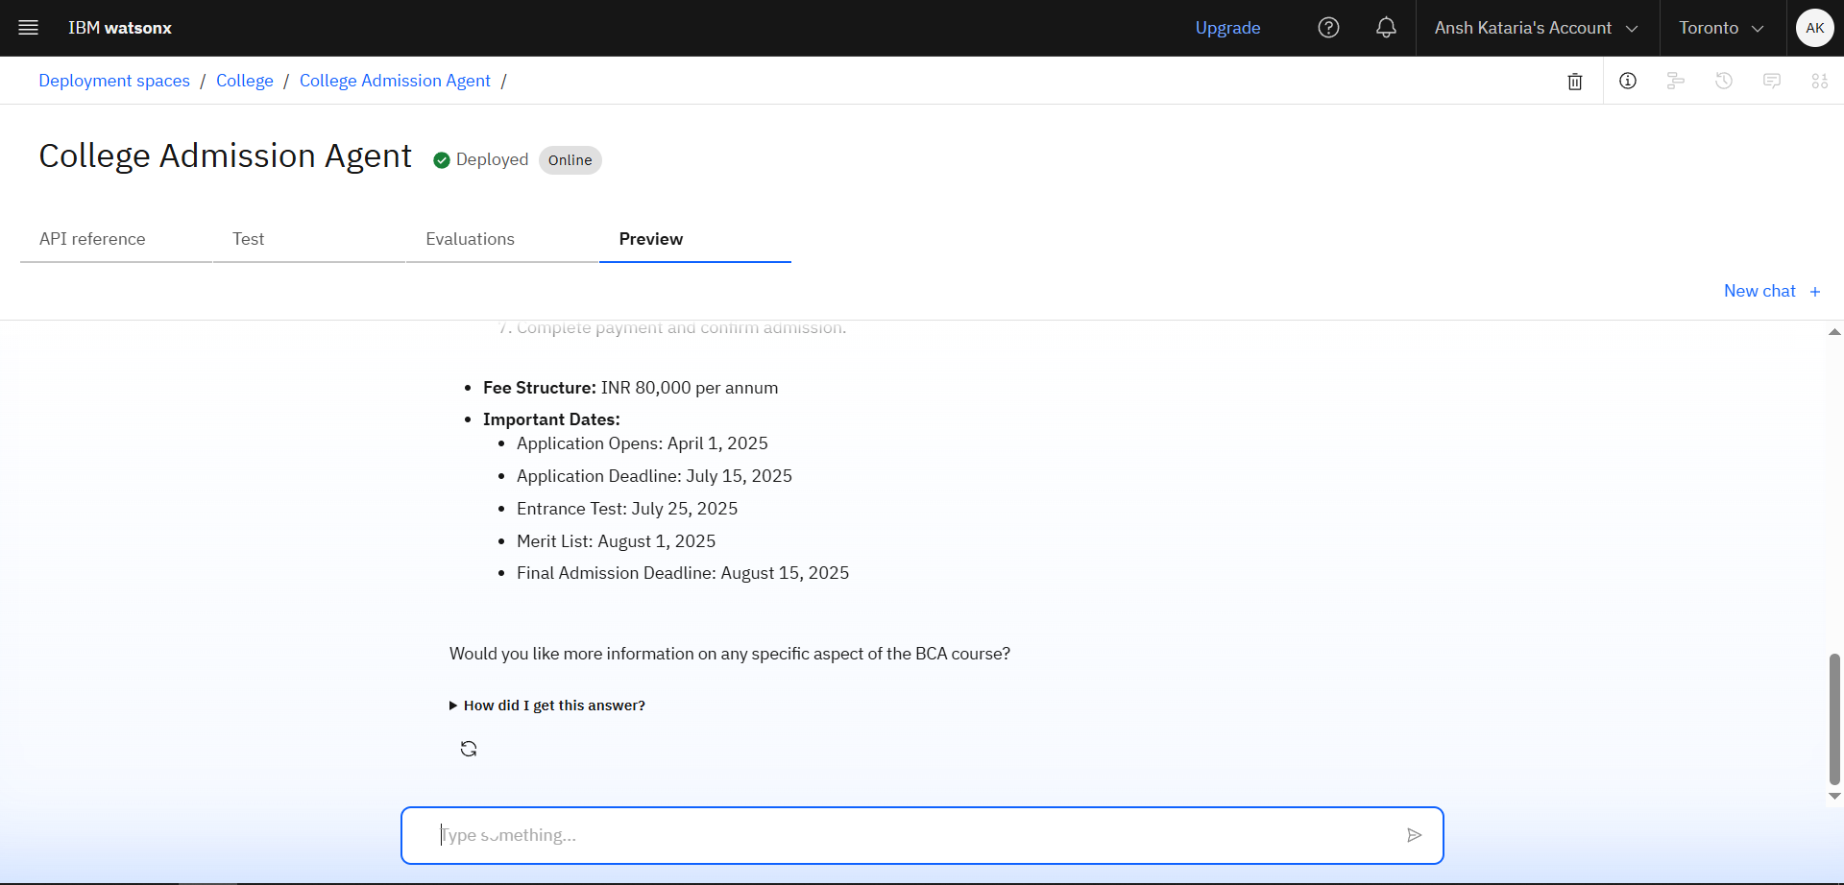
Results
Deployed AI Agent

Slide 15
Conclusion
Simplifies Admissions: The AI agent makes the admission process faster, clearer, and more student-friendly.
Boosts Engagement: Students get real-time, personalized help — anytime, anywhere.
Future-Ready Solution: Built on IBM Watsonx, it's scalable, secure, and adaptable to evolving institutional needs.

Slide 16
Future scope
Personalized Admission Counselling
Real-Time Application Tracking
Virtual Campus Tour Integration
Automated Notifications & Reminders
Live Chat with Human Support
Automated Notifications & Reminders

Slide 17
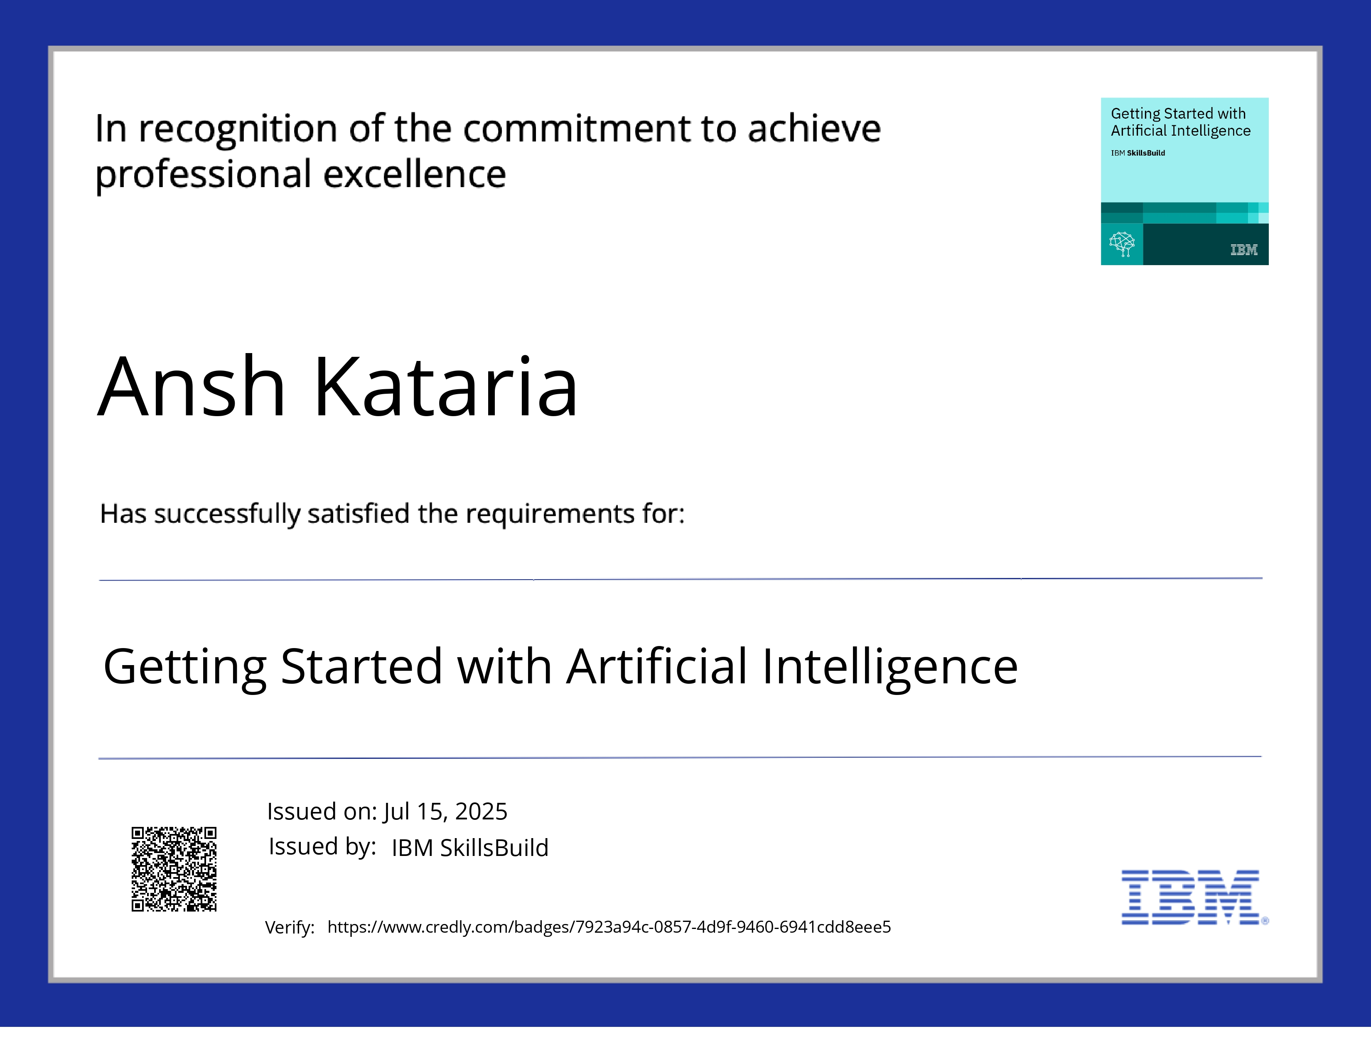
IBM Certifications

Slide 18
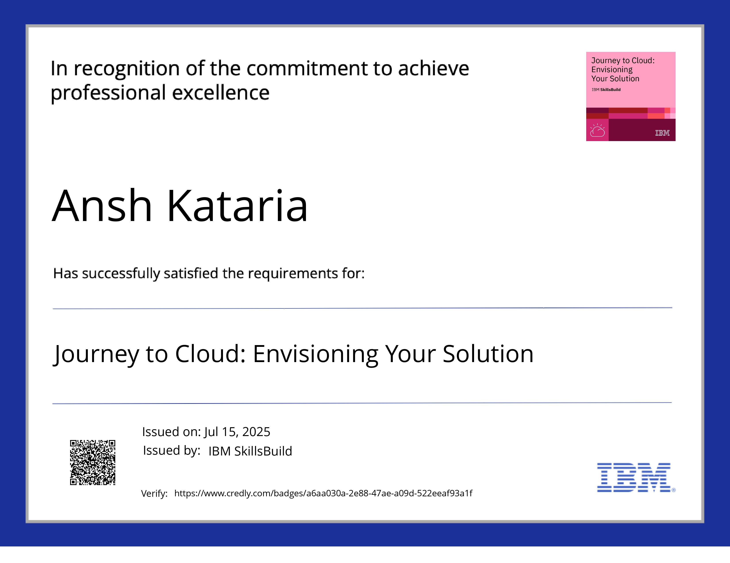
IBM Certifications

Slide 19
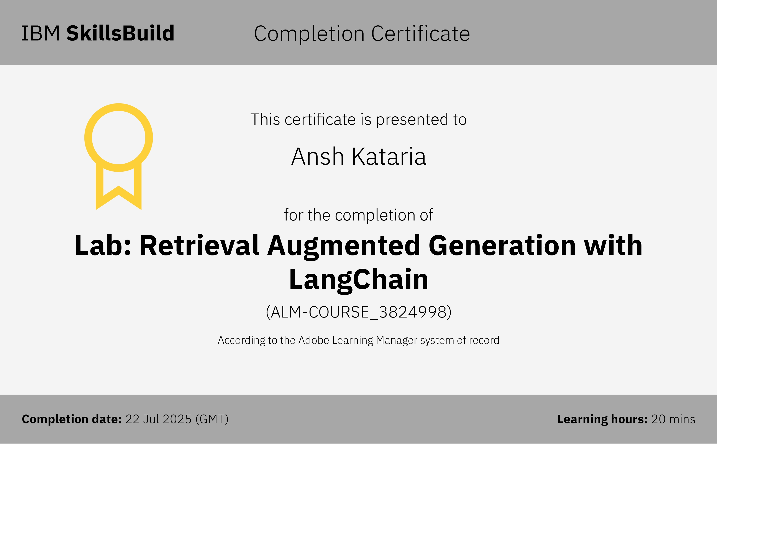
IBM Certifications

Slide 20
GitHub Link
https://github.com/Itzansh019/Edunet-IBM-Internship

Slide 21
THANK YOU

